Slide 1
Visualize and Analyze Energy Data
Lin Zhao | IOT Analytics Team

Slide 2
Agenda
Power Consumption Visualizations for three time periods
Power Consumption Visualizations for Sub-meter1,2,3
Time Series Forecast on Sub-meter 1,2,3 by Linear Regression Model
Decomposing a Seasonal Time Series on Sub-meter 1,2,3
Holt-Winters Exponential Smoothing & Forecast on Sub-meter 1,2,3
Any useful correlations or predictions you can glean from the data?
A Summary Statement that address the goals of this project. Has the goal been met?
Business Recommendations
Lesson Learned

Slide 3
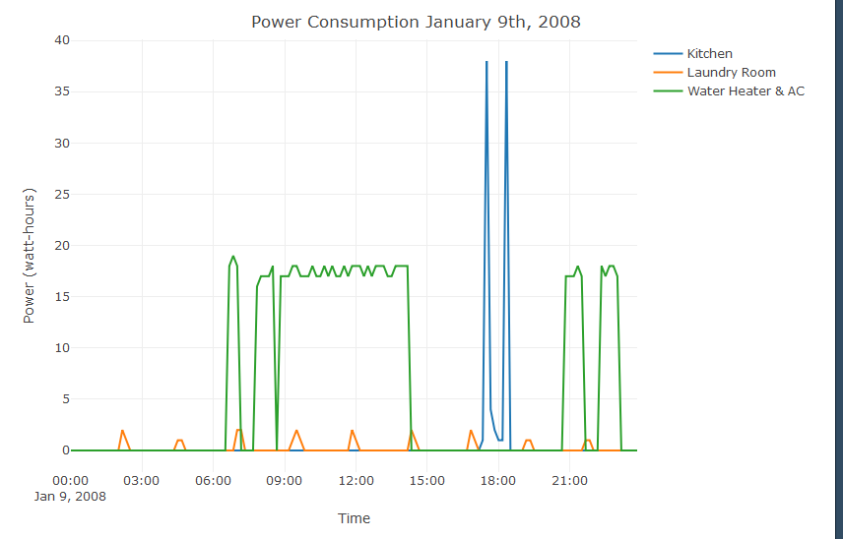
Power Consumption on January 9th, 2008
10 minutes interval & plot every 3 hours
Kitchen Rush Hour from 17:30-18:30 and reached to 38 watt-hours
Laundry Room power usage was evenly distributed throughout the day
High Water Heater & AC hours ( 6:00am-3:00pm and 9:00pm and thereafter) and reached to a max of 18-19 watt-hours

Slide 4
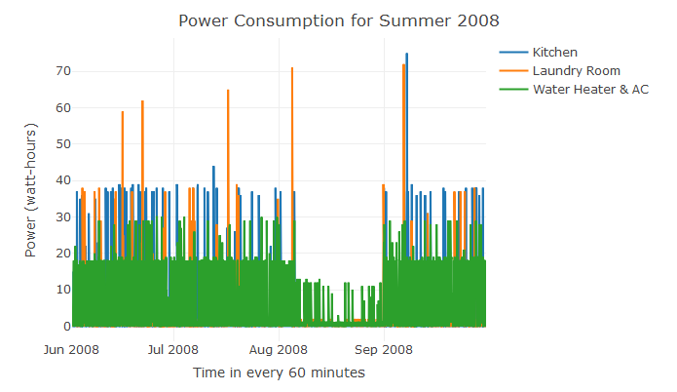
Power Consumption of Summer 2008
Data collected from June to September 2008
Spectacular volume & non-stop of Water Heater & AC consumption in Summer!
People tended to use more power in the Laundry room too due to the Summer
Kitchen Room remained the same throughout summer ( below 40 watt-hours)
Vacation period: in August (all 3 sub-meters were all low)

Slide 5
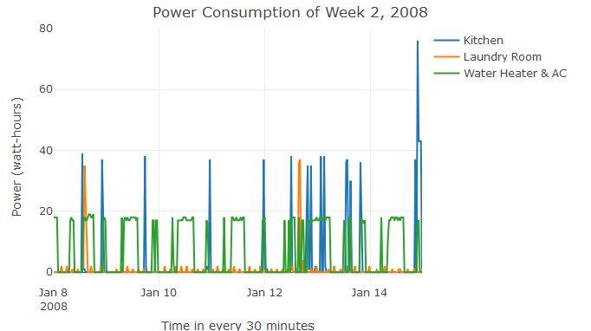
Power Consumption of Week 2, 2008
30 minutes interval & plot for a week
Kitchen power usage was normally distributed every day and reached to 38-39 watt-hours, except for Jan 14th
Laundry Room power usage was evenly distributed throughout the day, with two exceptions ( Jan 8th & Jan 12th )
Water Heater & AC power consumption were evenly distributed throughout the week

Slide 6
Sub Meter Set Mapping
Meter Set | Functional Room/Area | Appliances
Sub_metering_1 | Kitchen | Dishwasher, oven, microwave
Sub_metering_2 | Laundry Room | Washing machine, dryer, refrigerator and light
Sub_metering_3 | Garage & Yard | Water-heater and an air-conditioner

Slide 7
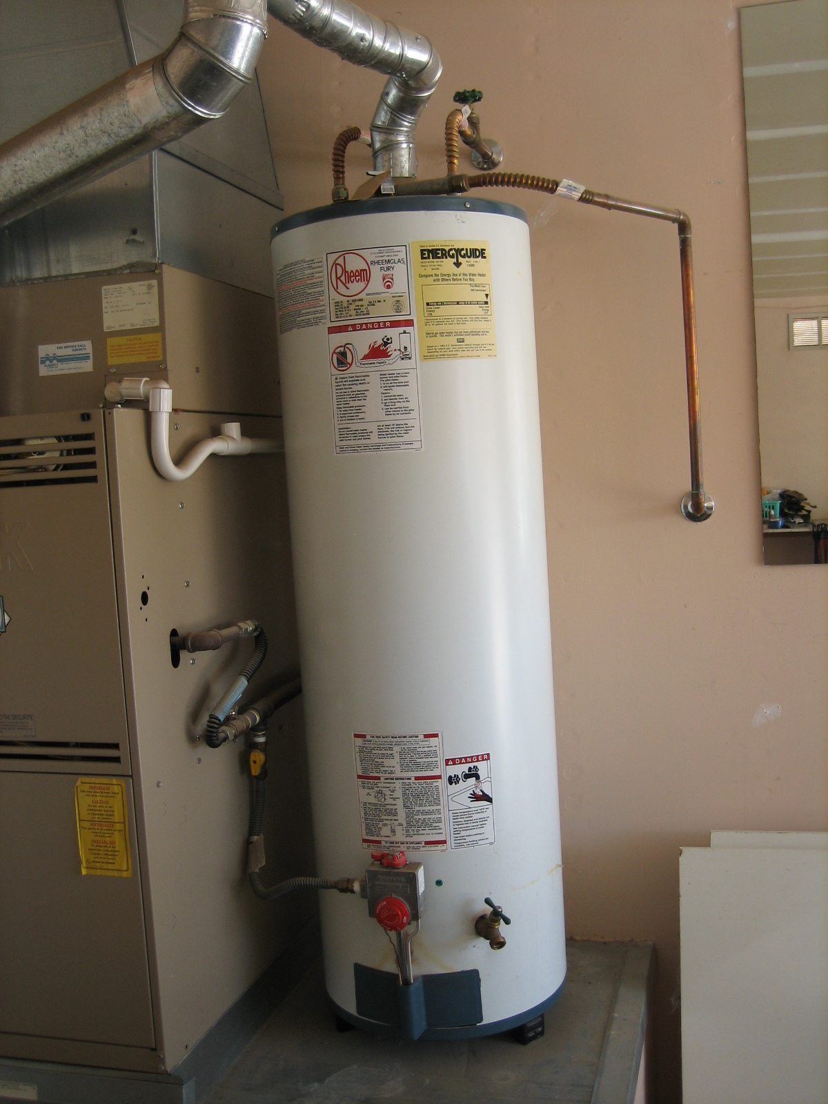
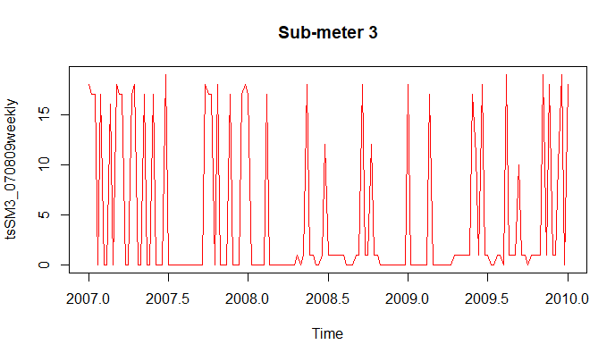
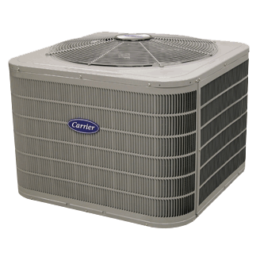
Garage & Yard 2007-2009 Weekly — Monday 8:00pm

Slide 8
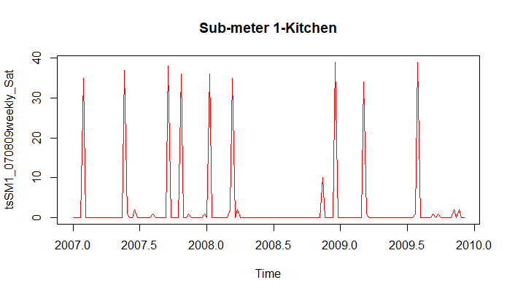
Kitchen 2007-2009 Weekly — @ 8:00pm
Measured every Saturday @ 8:00pm for 3 consecutive years
Several local minimum time periods i.e. 2007.1-2007.4, 2008.2-2008.10, 2009.2-2009.5, and 2009.6-2009.12
Kitchen power usage reached to 38-39 watt-hours, which matched my previous findings

Slide 9
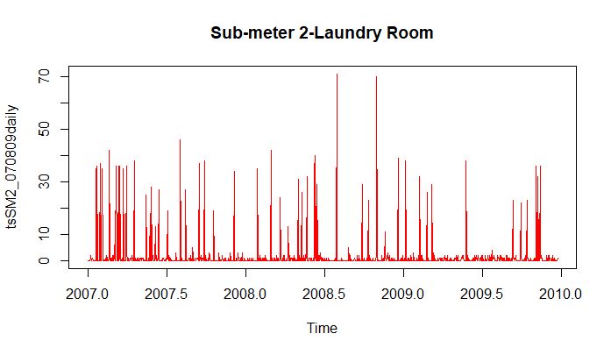
Laundry Room 2007-2009 Daily — @ 8:00pm
Data collected every day @ 8:00pm for 3 consecutive years
Over the years, people use laundry room between 30-40 watt-hours averagely, with two exceptions in 2008

Slide 10
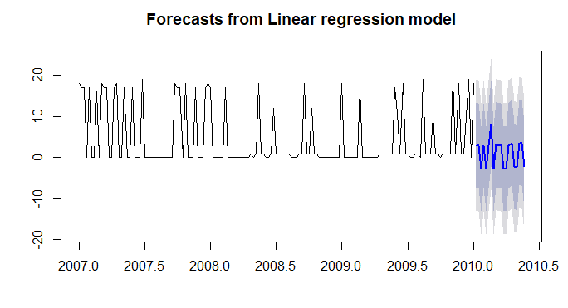

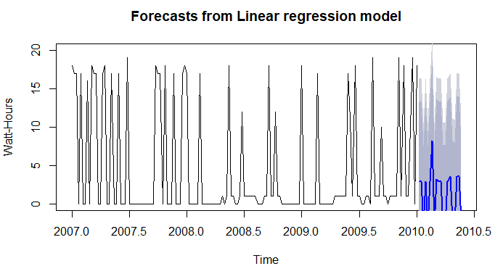

Linear Regression Model Forecast — Garage & Yard (every Monday at 8:00pm)
Gathered data from 2007-2009 every Monday @ 8pm
Using linear model to forecast Sub-meter 3 for 20 weeks (5 months) ahead
Plot 2 indicates 80-90 confidence interval and the value are above Zero Vs. Plot 1 has negative value which does not make sense

Slide 11
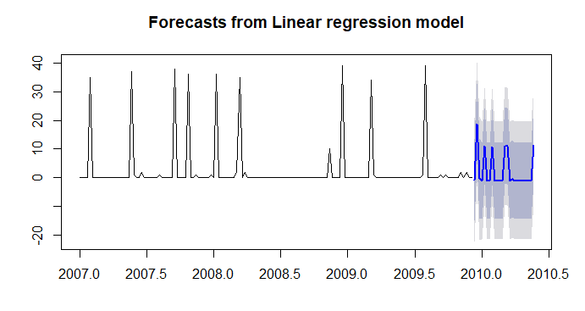
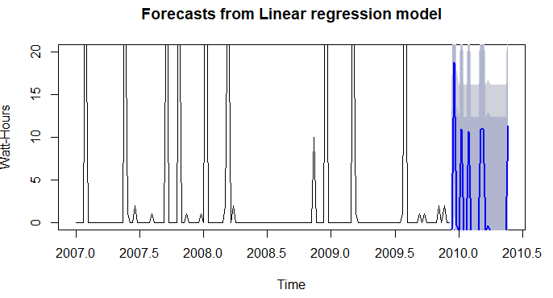
Linear Regression Model Forecast — Kitchen (every Saturday at 8:00pm)
Gathered data from 2007-2009 every Saturday @ 8pm
Using linear model to forecast Sub-meter 1 for 24 weeks (6 months) ahead
Plot 2 indicates 80-90 confidence interval and the value is about 15-20 watts-hours Vs. Plot 1 has negative value in y-axis which needs to be cut-off

Slide 12
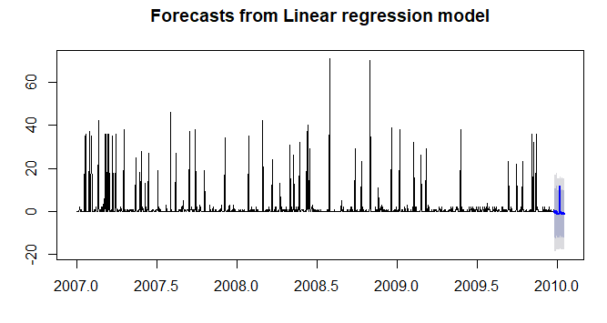
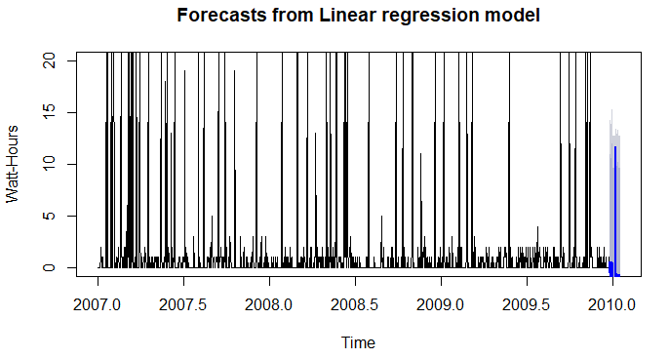
Linear Regression Model Forecast — Laundry Room (Daily at 8:00pm)
Gathered data from 2007-2009 every day @ 8pm
Using linear model to forecast Sub-meter 2 for 24 hours (1 day) ahead
Plot 2 indicates 80-90 confidence interval and the value is about 12-15 watts-hours Vs. Plot 1 has negative value in y-axis which needs to be cut-off

Slide 13
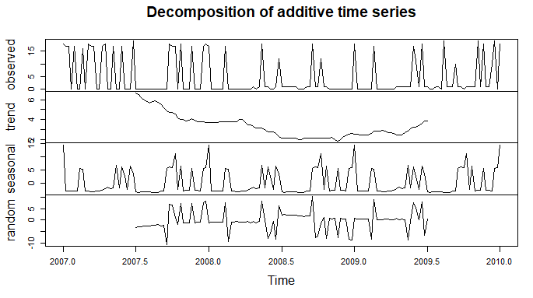
Decomposing a Seasonal Time Series — Garage & Yard (every Monday at 8:00pm)
Gathered data from 2007-2009 every day @ 8pm
Decompose Sub-meter 3 into trend, seasonal and random
It is necessary to adjust for seasonal component in order to understand what underlying trends are in the economy.

Slide 14
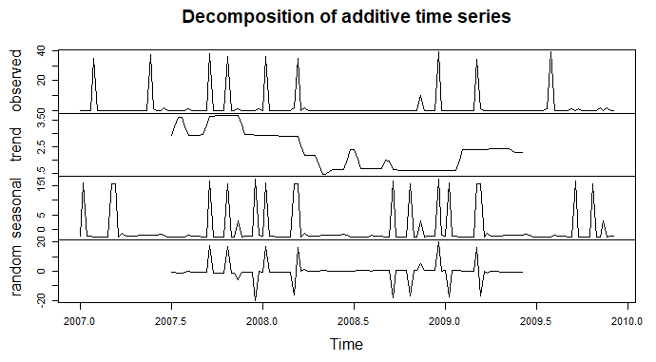
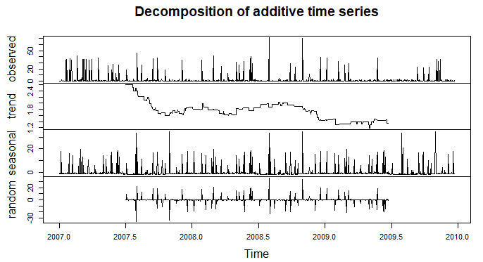
Kitchen(every Saturday at 8:00pm)
Decomposing a Seasonal Time Series
Laundry Room(every day at 8:00pm)

Slide 15
Comparison of summary statistics for the seasonal, trend and remainder components from each decomposed object
Functional Room | Technical Parameters | Min | 1st Quartile | Median | Mean | 3rd Quartile | Max | NA’s
Sub-meter 1 (Kitchen) | Seasonal | -2.53125 | -2.52163 | -2.17548 | -0.08844 | -1.84375 | 17.34375
 | Trend | 1.481 | 1.654 | 2.385 | 2.403 | 2.923 | 3.692 | 52
 | Random | -20.2861 | -0.7476 | -0.1226 | -0.1226 | 0.5024 | 20.0409 | 52
Sub-meter 2 (Laundry Room) | Seasonal | -2.19895 | -1.59895 | -1.37703 | 0.00654 | -0.62772 | 33.4489
 | Trend | 1.192 | 1.455 | 1.710 | 1.708 | 1.800 | 2.756 | 364
 | Random | -35.9737 | -.03832 | -0.0942 | -0.0942 | 0.1948 | 35.7853 | 364
Sub-meter 3 (Garage & Yard) | Seasonal | -3.70143 | -3.11008 | -2.81201 | 0.09312 | 5.50530 | 14.62068
 | Trend | 1.865 | 2.481 | 3.058 | 3.329 | 3.817 | 6.663 | 52
 | Random | -10.5726 | -1.5341 | -0.1784 | -.02217 | 1.0909 | 10.1293 | 52

Slide 16
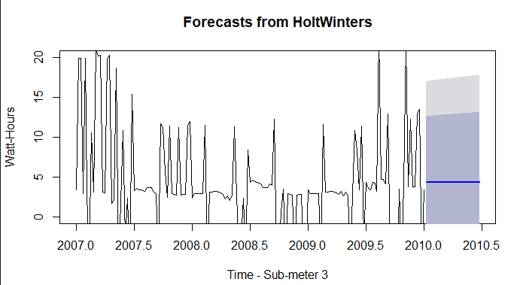
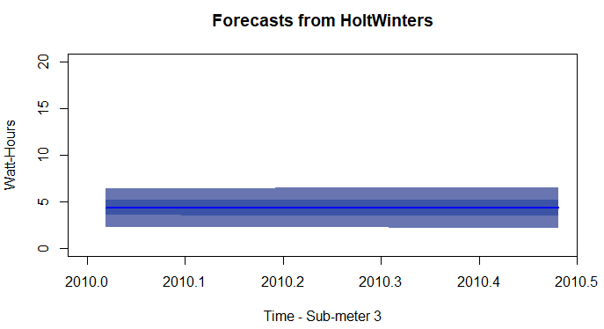
Holt-Winters Exponential Smoothing & Forecast — Garage & Yard (every Monday at 8:00pm)
Contains exponentially smoothed data with NO seasonality
Official statistics are often “seasonally adjusted” to remove seasonal components.
Forecast 5 months ahead
Plot 2-change the confidence levels and only plot the forecasted area. Not including the preceding years, weeks and days.

Slide 17
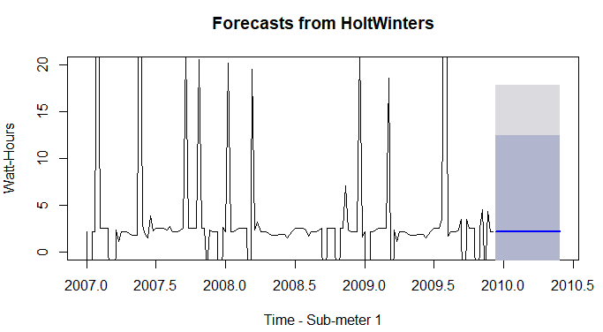
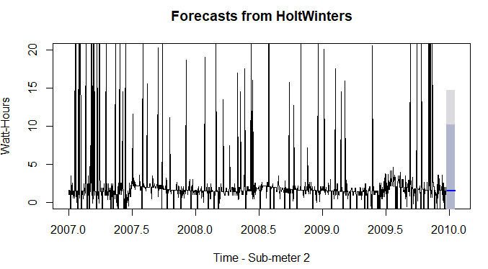
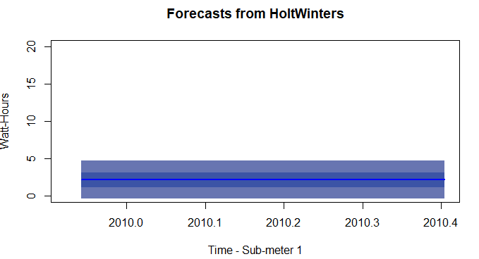
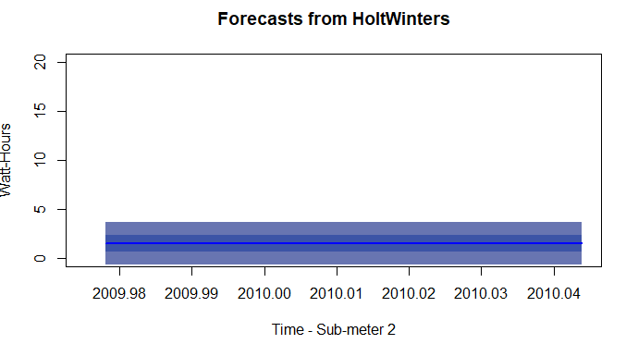
Kitchen (every Saturday at 8:00pm)
Holt-Winters Exponential Smoothing & Forecast
Laundry Room (every day at 8:00pm)

Slide 18
Any useful correlations or predictions you can glean from the data?
Multiple R-square, Adjusted R-square and Residual Standard Error Values are too low to have any statistical meaning
Linear Regression Model might not be a good model here
Holt-Winters Exponential Smoothing moving average is good measuring tool for future forecast as it is “Seasonal Adjusted” and it is used to assign exponentially decreasing weights over time to reduce the recent high frequency noise

Slide 19
A summary statement that addresses the goal of this project. Has the goal been met?
Analyzing the past 47 months of individual household electric power consumption from these sub-metering devices and providing our recommendation to Regional home developer
YES! We got enough data to analyze and to make recommendations
Applying analytics and visualizations that would empower Smart Homeowners with greater understanding and control of their power usage
YES! By applying the Sub-Meters, homeowner can easily track down the power consumption in each category of appliances
Our potential client’s goal with these sub-meters is to grow their business in the smart home market
YES! Our client’s goal has been achieved. Based on my recommendations, two more sub-meters will be installed as well. Therefore, there will be a huge room for potential growth of their business in the long run

Slide 20
Business Recommendations 1
Re-categorize devices by their consumption patterns for easier realization of potential savings – See next page for details
Consider to add Sub_metering_4 to separate the water-heater and AC, as both are highly consumed appliances especially during the summer
Consider to add Sub_metering_5 for the refrigerator, so we can easily track down the only household consumption during vacation mode.
Consider to set the thermostat of AC for each season in order to keep the room within a comfortable temperature throughout the year to achieve the energy saving goal in the long run
Develop a temperature reminder App. Homeowner can receive real-time alert when the power consumption reaches certain limit

Slide 21
Business Recommendations 2 Suggested re-organized Sub-metering allocations
Meter Set | Appliances
Sub_metering_1: (Auto Turn-Off) | Light, oven, microwave Turn off automatically when nobody is around
Sub_metering_2: (Need-Based) | Washing machine, drier, and dishwasher (Can work when nobody is around)
Sub_metering_3: (High Consumption) | Water-heater (higher consumption in kwh)
*Sub_metering_4: (High Consumption) | Air-conditioner (higher consumption in kwh)
*Sub_metering_5: (Vacation Mode) | Refrigerator (the only working appliance when nobody is home for a short period)
Notes:
May require more than one slide

Slide 22
Lesson Learned
Subset the original dataset to meaningful time periods
Adjust granularity in order to reach the best visualization by ‘Plotly’ package
Apply Time Series(ts) to analyze data by different frequencies/time intervals
Use Linear Regression Model(tslm) to forecast the ahead N time periods
Decompose a seasonal Time Series to three sections: trend, seasonal and random
Holt Winters simple exponential smoothing made the scale of seasonal factor to a very small number by removing the seasonal component from the original dataset. Meanwhile to set the alpha & gamma value to False in order to put less weight on the most recent data
Holt Winters Model do not include the preceding years, weeks and days

